Slide 1



Clinical Problem Solving INTERNAL MEDICINE
IN THE NAME OF GOD
Melika hassani, MD
CARDIOLOGY RESIDENT

Slide 2

ID
37-year-old woman
From tehran
Married, housewife, with two children

Slide 3
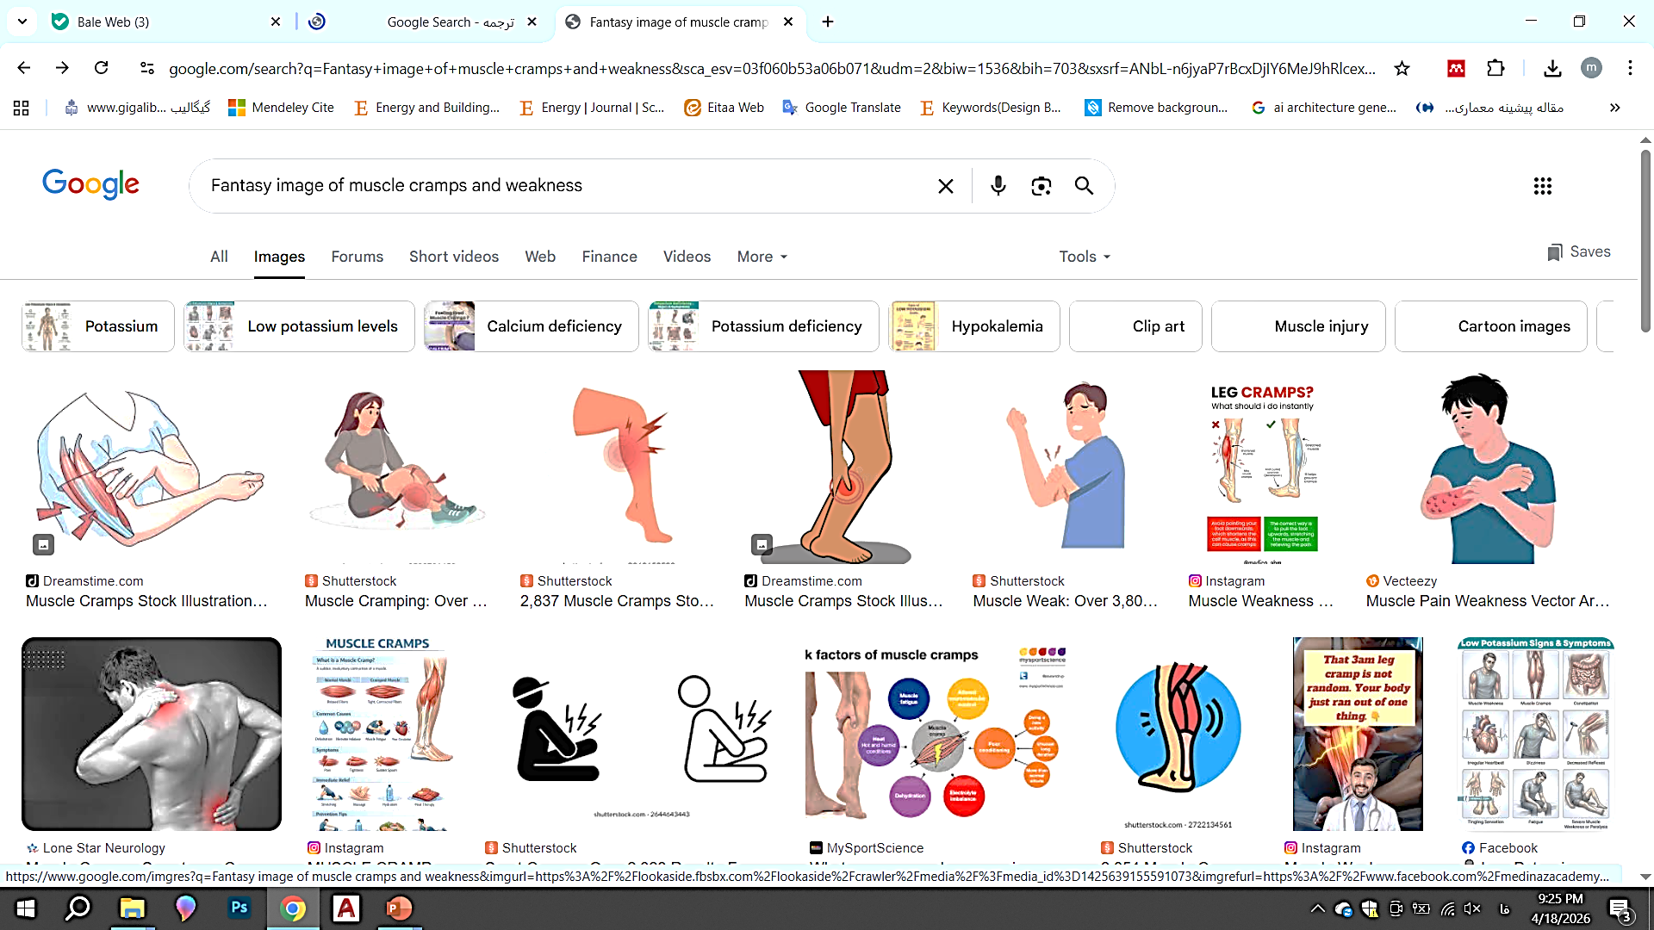
CHIEF COMPLAINT
muscle cramps and weakness

Slide 4

Present Illness
37-year-old female presented with hypokalemia following routine tests during follow-up after an abdominal surgery (subsequent to the rupture of the diaphragm) 3 years before the final diagnosis. She had muscle cramps and weakness along with hypokalemia.
In the first year after the diagnosis of hypokalemia, no specific diagnostic or therapeutic measures are taken. The patient is only advised to take potassium supplements.

Slide 5
Step 1

Slide 6
Past Medical History
In 1990, he underwent endoscopy for dysphagia, and was diagnosed with a mass, possibly a fibroid at the end of the esophagus, which was surgically removed.
In 1992, he suffered from abdominal pain and was diagnosed with a ruptured diaphragm and underwent surgery.

Slide 7
Past Surgical History : abdominal surgery (subsequent to the rupture of the diaphragm)
Drug History :
no specific diagnostic or therapeutic management except high potassium intake in the first year after the detection of hypokalemia.
Social History : Unremarkable. Allergy History :No known drug allergies.
Family History :Family history for hypertension was negative. There was a history of diabetes mellitus in her mother, sister and two brothers. There was a history of proteinuria in her mother (possibly diabetic nephropathy).

Slide 8



Review of Systems
General: Negative for fever or night sweats.
Dermatologic: Negative for rash, skin thickening.
Eyes : No visual disturbances, eye pain, redness, or dryness
Ear :No hearing loss, tinnitus, ear pain, or discharge.
Nose :No nasal congestion, rhinorrhea, epistaxis, or sinus pain .
Cardiovascular: Negative for chest pain, palpitations, orthopnea, or syncope.
Respiratory: Negative for cough, wheezing, hemoptysis, or pleuritic chest pain

Slide 9



Review of Systems
Gastrointestinal:Negative for nausea, vomiting, abdominal pain, diarrhea, constipation, melena, or hematochezia.
Genitourinary: Negative for dysuria, hematuria, urinary frequency, urgency, or change in urine output.
Musculoskeletal: Negative for myalgia, arthralgia, joint swelling, or morning stiffness. She complains of muscle cramps
Endocrine: Negative for heat or cold intolerance, polyuria, or polydipsia.
Hematologic: Negative for easy bruising or bleeding.
Neurologic: She complains of weakness.Negative for headache, syncope, focal neurologic deficits, or seizures.
Psychiatric: Negative for depression, anxiety, or sleep disturbance.

Slide 10

Physical exam
The patient appears alert, oriented, and in no acute distress at rest.
Vital Signs
Blood pressure: BP= 120/70 mmHg
Heart rate: 65 beats per minute
Respiratory rate: 17 breaths per minute
Temperature: 36.9 °C
Oxygen saturation: 96% on room air
W=70 kg
H= 163 cm
BMI=26.3 kg/m2

Slide 11

Skin: Normal in appearance, texture, and temperature. No rash, or ulcers.
Head and Neck: The Conjunctiva is not pale, the Sclera is not icteric .The size of the pupils is normal and reactive .no Cyanosis of lips and mouth. no bruit in the carotid artery area
Scalp normal. Pupils equally round, 4 mm, reactive to light and accommodation, sclera and conjunctiva normal. Fundoscopic examination reveals normal vessels without hemorrhage. Tympanic membranes and external auditory canals normal. Nasal mucosa normal. Oral pharynx is normal without erythema or exudate. Tongue and gums are normal.
Cardiovascular: heart sounds were normal with regular rate and rhythm. No murmurs, rubs, or gallops. No heave or thrill
Respiratory: Chest expansion normal . lungs clear to auscultation bilaterally.No wheezing, crackles, or rhonchi.

Slide 12
Abdomen: The abdomen is symmetrical without distension; bowelsounds are normal in quality and intensity in all areas;. No masses or splenomegaly are noted.
Extremities: No cyanosis, clubbing, or edema are noted. Peripheral pulses in the femoral, popliteal, anterior tibial, dorsalis pedis, brachial, and radial areas are normal.
Neurologic:
Cranial nerves II-XII are normal. Gait and cerebellar function are also normal. Reflexes are normal and symmetrical bilaterally in both extremities .Grossly intact. No focal neurologic deficits.
Proximal and distal force decreased(4/5)

Slide 13
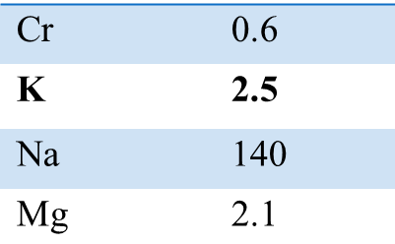
1ST LAB

Slide 14
Step 2

Slide 15

Present Illness
After a year, she was referred to a nephrologist because her weakness progressed, and she developed polyuria, nocturia and headache. She was admitted several times due to severe hypokalemia and weakness. During this period, she received the following medications to control hypokalemia: Intravenous potassium chloride and various oral medications including spironolactone up to maximum 500 mg per day (discontinued due to menstrual disorders); eplerenone 100 mg twice daily; potassium chloride 600 mg tablets up to 5 doses per day. Within all outpatient and inpatient visits, the blood pressure was normal

Slide 16
2ND LAB(after 2 weak)
Na | 138
k | 3.3

Slide 17
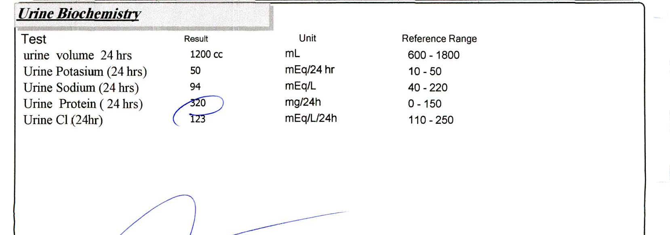
TTKG = 15.3

Slide 18
3ND LAB(after 4 month)
Na | 143
k | 3.1

Slide 19
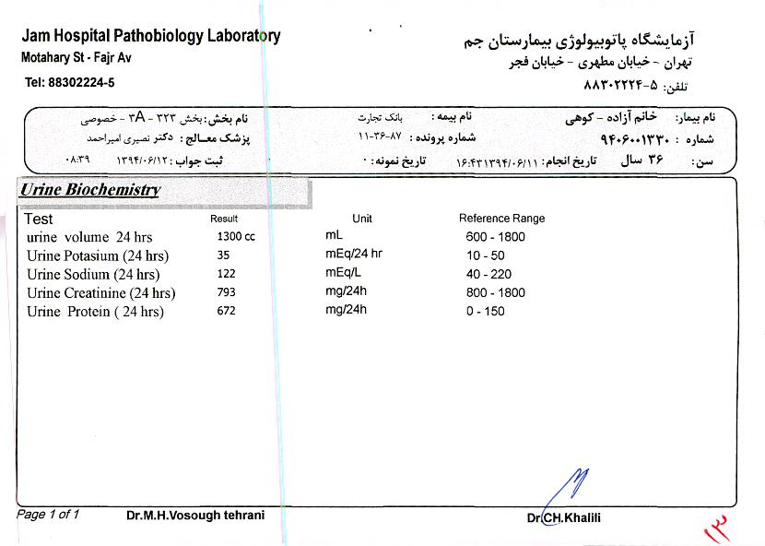

Slide 20
4ND LAB(after 3 month)
Na | 137
k | 2.8

Slide 21
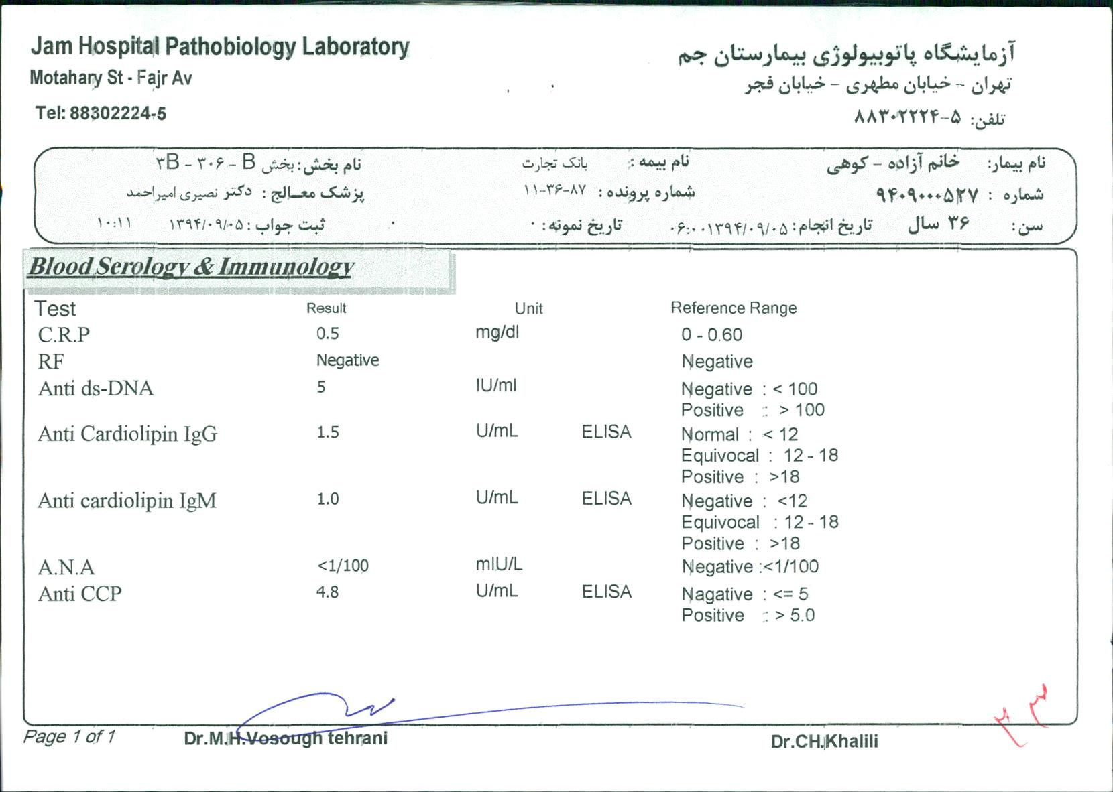

Slide 22
Step 3

Slide 23
Two years later, following a urinary tract infection (UTI), she was admitted to the hospital. A computed tomography scan was ordered to rule out complicated pyelonephritis. Incidentally a homogenous well-defined mass of 21 × 17 mm and HU= -10 was detected in the left adrenal

Slide 24
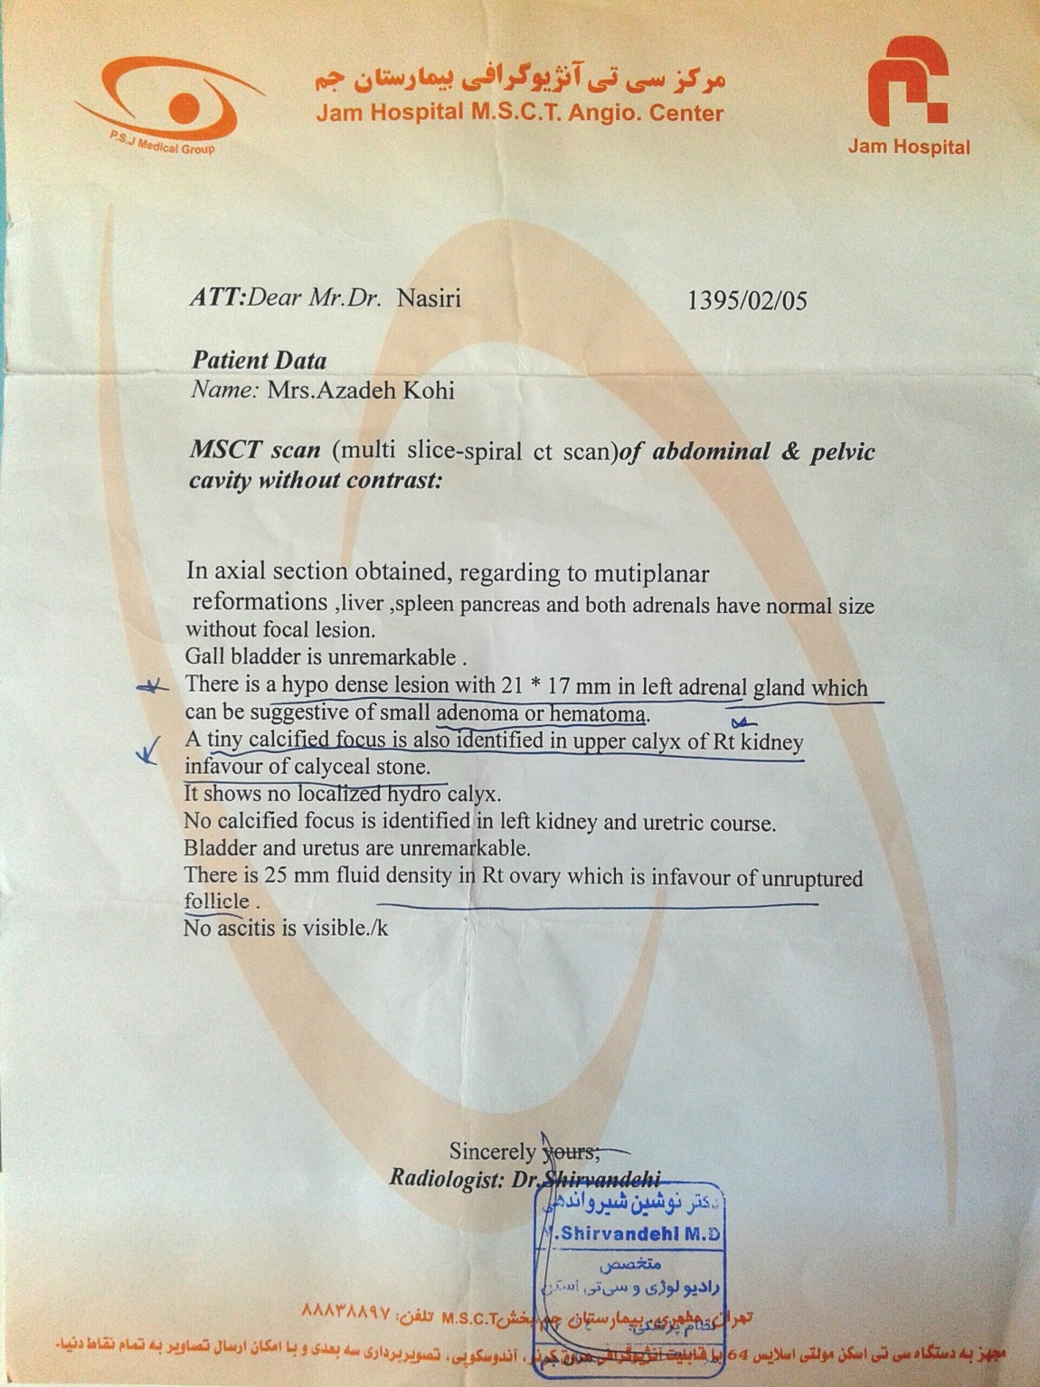

Slide 25
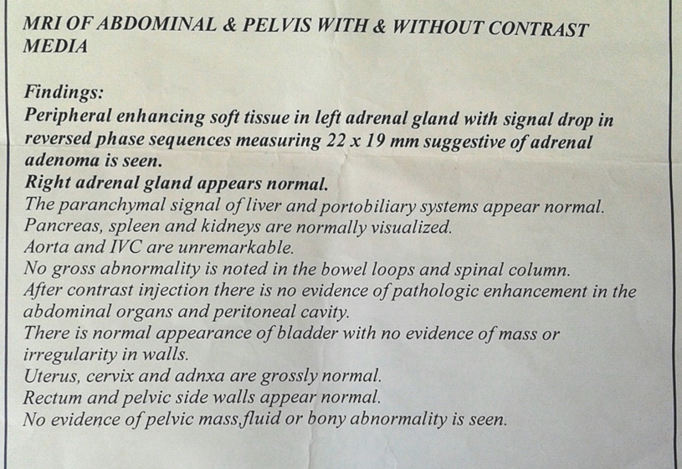

Slide 26
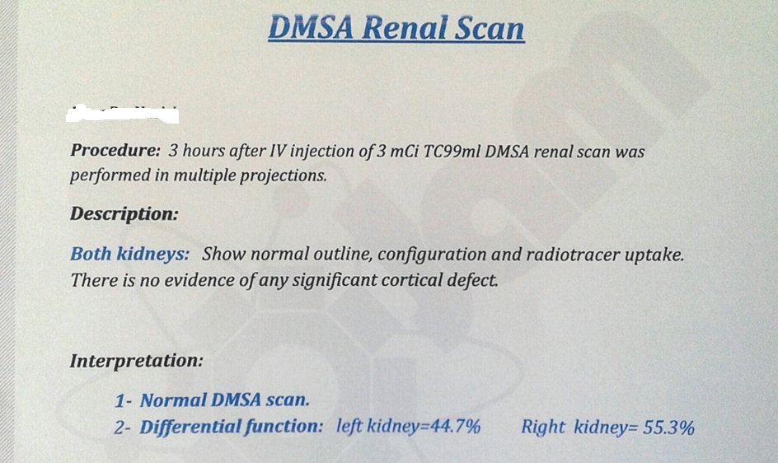

Slide 27
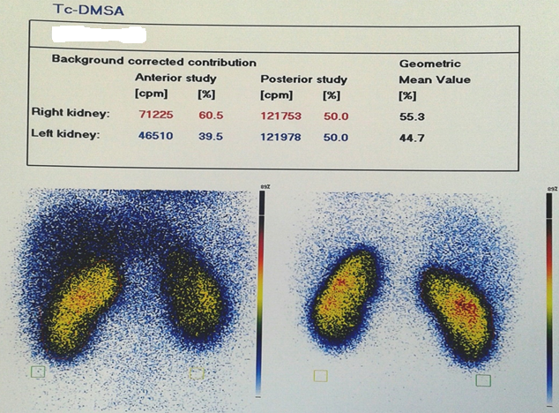

Slide 28
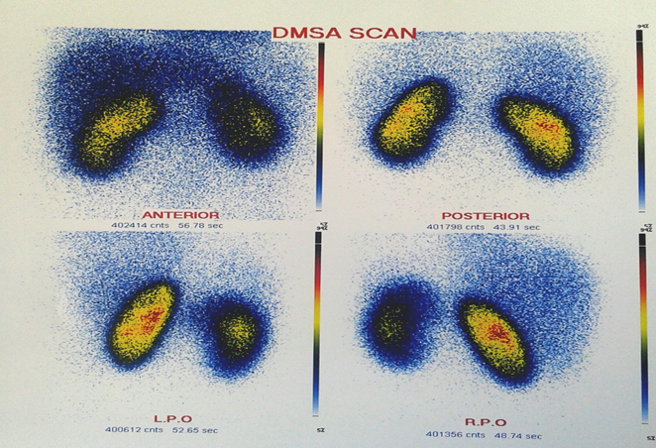

Slide 29
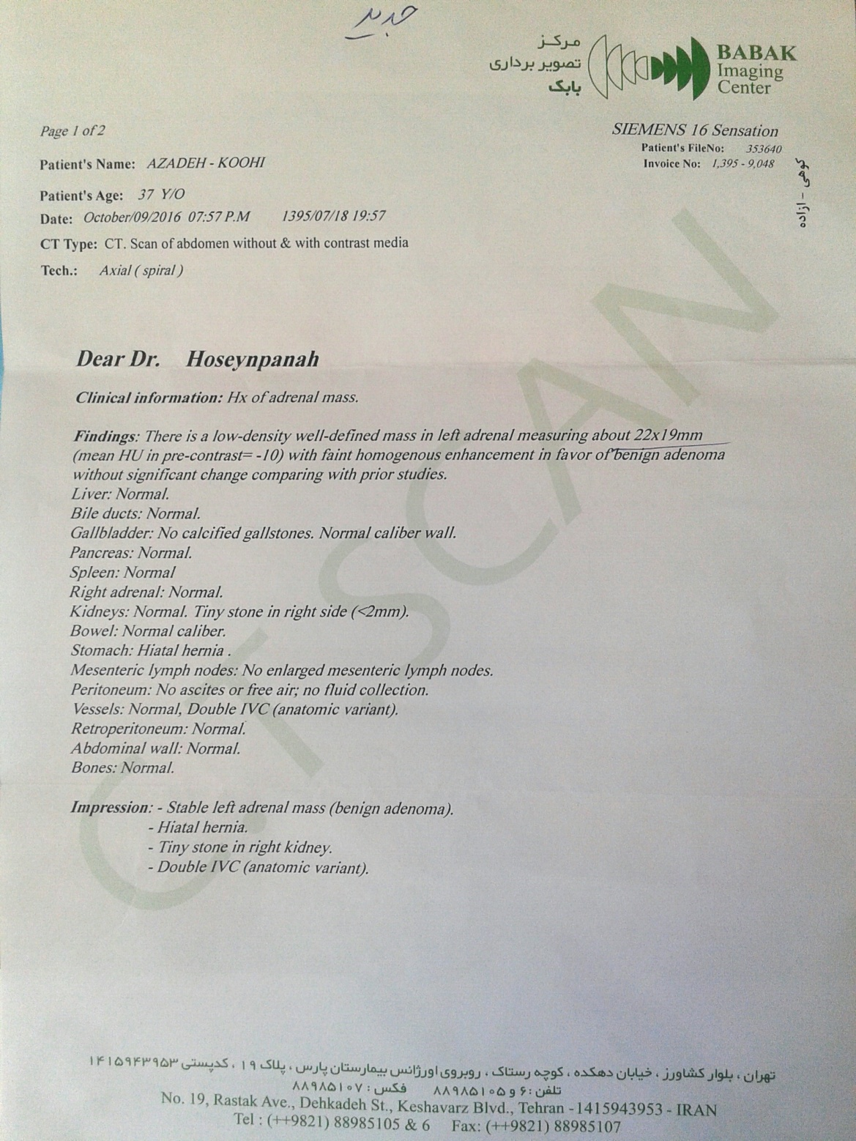

Slide 30
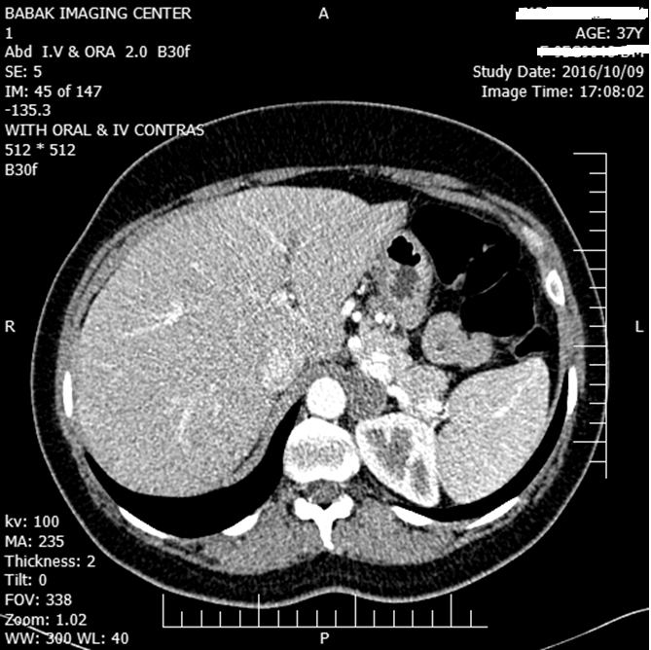

Slide 31
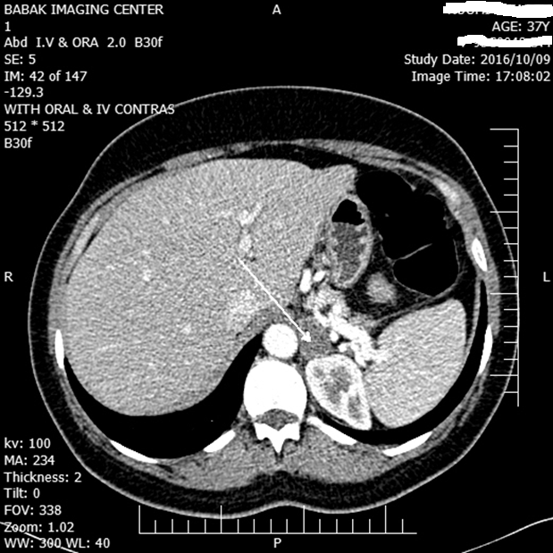

Slide 32
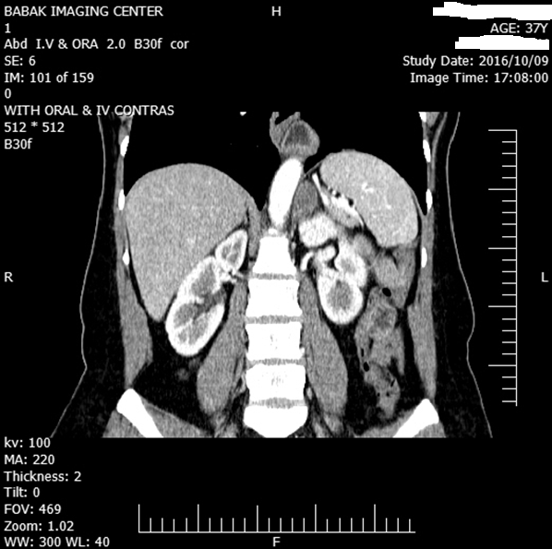

Slide 33
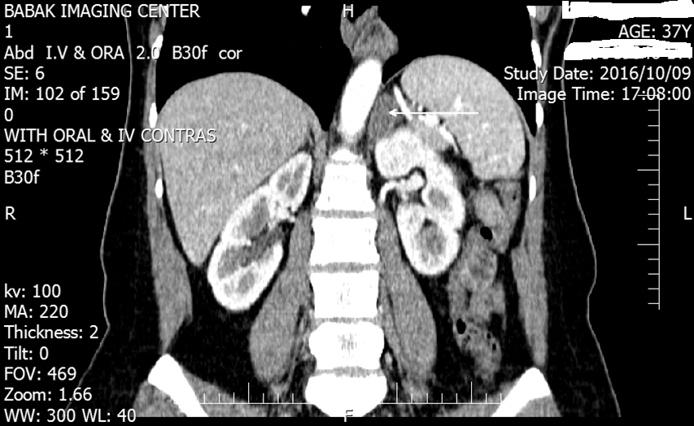

Slide 34
Ald/PRA ratio = 41.6
95/7/17 | 95/6/1 | 95/5/24
0.8 |  | 0.9 | Cr
2.6 | 3 | 3.3 | K
141 |  | 143 | Na
 |  | Trace | U/A (Alb)
 | pg/ml (20-180) 250 | 392 pg/ml (40-310) | Ald
 | 0.6 ng/ml/h (0.2-1.6) |  | PRA

Slide 35
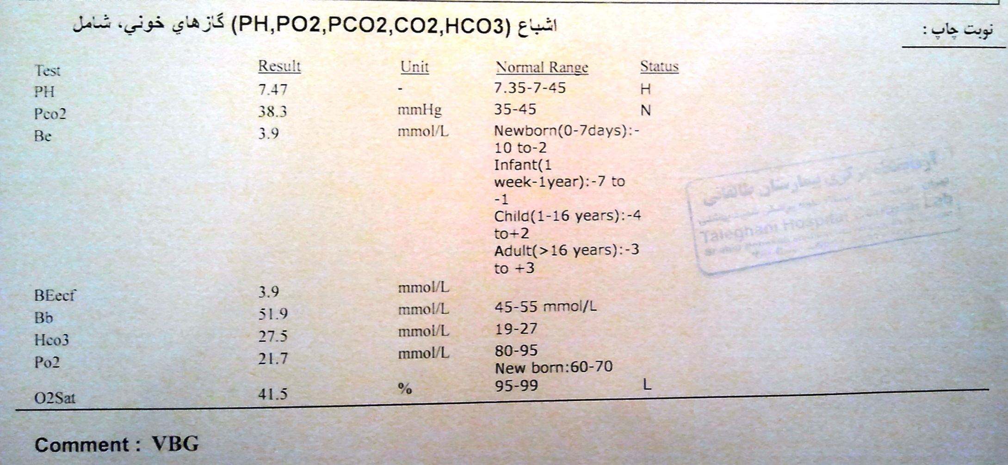

Slide 36

Considering the possible interference of eplerenone with the results of aldosterone/renin ratio (ARR) -potassium-sparing diuretics increases the level of renin and then causes a false negative of ARR- therefore, the suppression of renin level along with the strongly positive ARR level in our patient (41.6 ng/dl/ng/ml/h) was considered a positive test, and no confirmatory tests were ordered.

Slide 37

Laboratory Results
Table 1: blood pressure and lab findings of patient from first to last visit before surgery
 | BP Max/Min (mmHg) | Cr (mg/dl) | K⁺ (mEq/l) | Na⁺ (mEq/l) | Mg⁺⁺ (mg/dl) | Protein in Urine (mg/24h) | WBC(/µl) Hb(g/dl) Plt(/µl) | TSH (µIU/ml) | VBG PH HCO3(mmol/l) PCO2(mmHg) | PAC (ng/dl) | PRA (ng/ml/h)
*First admission (18/04/2015) | 120/70 | 0.6 | 2.5 | 140 | 2.1 | 320 | 7300 11.8 210000 | 1.93
Second admission (30/04/2015) | 120/70 |  | 3.3 (TTKG=15.3) | 138
Third admission (01/10/2015) | 120/70 |  | 3.1 | 143 |  | 672
Forth admission (11/06/2016) | 130/90 | 0.6 | 3.3 | 137 | 2.3 |  |  | 2.2 | 7.47 27.5 38.3 | 39 (4-31) | N/A
Final lab tests (before surgery) (22/06/2016) | 140/95 | 0.9 | 3 | 143 |  |  |  |  |  | 25 (2-18) | 0.6 (0.2-1.6)

Slide 38

Problm list
37-year-old woman with weakness, muscle cramps, headache, polyuria, nocturia
Hypokalemia
High TTKG
Metabolic alkalosis
Proteinuria
High Ald level and Ald/PRA ratio
Left adrenal mass
Right kidney stone

Slide 39

In postoperative visit, hypokalemia was resolved without any medication and blood pressure was 100/70 mmHg. In several visits after surgery, the average blood pressure of the patient was 95/60 mmHg and potassium level are still within the normal range without any medical treatment even after 3 years.
Outcome & Conclusion
health team decided to recommend laparoscopic surgery. Ultimately, laparoscopic surgery was performed and left adrenalectomy was done. The pathology report revealed adrenal adenoma.

Slide 40

Dx:
Normotensive Primary Hyperaldosteronism
Primary aldosteronism should be among the differential diagnoses in normotensive patients presenting with severe hypokalemia.
با سپاس از توجه و همراهی شما

